Slide 1
CISC3130: awk
Xiaolan Zhang
Spring 2013

Slide 2
Outlines
Overview
awk command line
awk program model: record & field, pattern/action pair
awk program elements: variable, statement
Variable, Expression, Function
Numeric operators
String functions
Array variable
Function
User-controlled input
Input/Output Redirection
External command

Slide 3
awk: what is it?
programming language was designed to simplify many common text processing tasks
Online manual: info system vs. man system
Version issue: old awk (before mid-1980, and after)
awk, oawk, nawk, gawk, mawk …

Slide 4
Overview
awk [ -F fs ] [ -v var=value ... ] 'program' [ -- ] [ var=value ... ] [ file(s) ]
awk [ -F fs ] [ -v var=value ... ] -f programfile [ -- ] [ var=value ... ] [ file(s) ]
-F option: specified field separator
Program:
Consists of pairs of pattern and braced action, e.g.,
/zhang/ {print $3} NR<10 {print $0}
provided in command line or file …
Initialization:
With –v option: take effect before program is started
Other: might be interspersed with filenames, i.e., apply to different files supplied after them

Slide 5
awk script/program
Demo:
$ average.awk avg.data
An executable file
#!/bin/awk –f
BEGIN{
lines=0;
total=0;
}
{
lines++;
total+=$1;
}
END{
if (lines>0)
print “agerage is “, total/lines;
else
print “no records”
}

Slide 6
awk programming model
Input: awk views an input stream as a collection of records, each of which can be further subdivided into fields.
Normally, a record is a line, and a field is a word of one or more nonwhite space characters.
However, what constitutes a record and a field is entirely under the control of the programmer, and their definitions can even be changed during processing.
Input is switched automatically from one input file to next, and awk itself normally handles opening, reading,and closing of each input file
Programmer do not worry about this

Slide 7
awk program
An awk program: consists of pairs of patterns and braced actions, possibly supplemented by functions that implement actions.
For each pattern that matches input, action is executed; all patterns are examined for every input record
pattern { action } ##Run action if pattern matches
Either part of a pattern/action pair may be omitted.
If pattern is omitted, action is applied to every input record
{ action } ##Run action for every record
If action is omitted, default action is to print matching record on standard output
pattern ##Print record if pattern matches

Slide 8
Awk pattern
Pattern: a condition that specify what kind of records the associated action should be applied to
string and/or numeric expressions: If evaluated to nonzero (true) for current input record, associated action is carried out.
Or an regular expression (ERE): to match input record, same as $0 ~ /regexp/
NF = = 0 Select empty records
NF > 3 Select records with more than 3 fields
NR < 5 Select records 1 through 4
(FNR = = 3) && (FILENAME ~ /[.][ch]$/) Select record 3 in C source files
$1 ~ /jones/ Select records with "jones" in field 1
/[Xx][Mm][Ll]/ Select records containing "XML", ignoring lettercase
$0 ~ /[Xx][Mm][Ll]/ Same as preceding selection

Slide 9
BEGIN, END pattern
BEGIN pattern: associated action is performed just once, before any command-line files or ordinary command-line assignments are processed, but after any leading –v option assignments have been done.
normally used to handle special initialization tasks
END pattern: associated action is performed just once, after all of input data has been processed.
normally used to produce summary reports or to perform cleanup actions

Slide 10
Action
Enclosed by braces
Statements: separated by newline or ;
Assignment statement
line=1
sum=sum+value
print statement
print ″sum= ″, sum
if statement, if/else statement
while loop, do/while loop, for loop (three parts, and one part)
break, continue

Slide 11
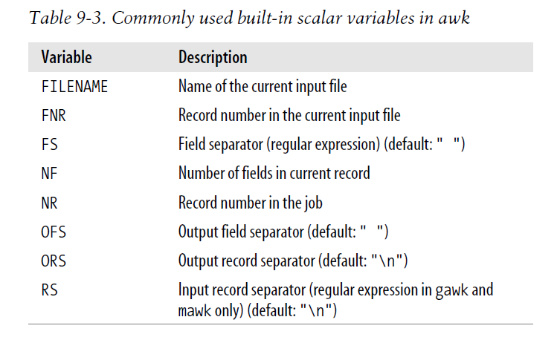
$0 the current record
$1, $2, … $NF the first, second, … last field of current record

Slide 12
Simple one-line awk program
Using awk to cut
awk -F ':' '{print $1,$3;}' /etc/passwd
To simulate head
awk 'NR<10 {print $0}' /etc/passwd
To count lines:
awk ‘END {print NR}’ /etc/passwd
What’s my UID (numerical user id?)
awk –F ‘:’ ‘/^zhang/ {print $3}’ /etc/passswd

Slide 13
Doing something new
Output the logarithm of numbers in first field
echo 10 | awk ‘{print $0,log($0)}’
Sum all fields together
awk '{sum=0; for (i=1;i<NF;i++) sum+=sum+$i; print sum}' data2
How about weighted sum?
Four fields with weight assignments (0.1, 0.3, 0.4,0.2)
awk '{sum= $1*0.1+$2*0.3+$3*0.4+$4*0.2; print sum}' data2

Slide 14
Outlines
Overview
awk command line
awk program model: record & field, pattern/action pair
awk program elements: variable, statement
Variable, Expression, Function
Numeric operators
String functions
Array variable
Function
User-controlled input
Input/Output Redirection
External command

Slide 15
Awk variables
Difference from C/C++ variables
Initialized to 0, or empty string
No need to declare, variable types are decided based on context
All variables are global (even those used in function, except function parameters)
Difference from shell variables:
Reference without $, except for $0,$1,…$NF
Conversion between numeric value and string value
N=123; s=“”N ## s is assigned “123”
S=123, N=0+S ## N is assigned 123
Floating point arithmetic operations
awk '{print $1 “F=“ ($1-32)*5/9 “C”}' data
echo 38 | awk '{print $1 “F=“ ($1-32)*5/9 “C”}'

Slide 16
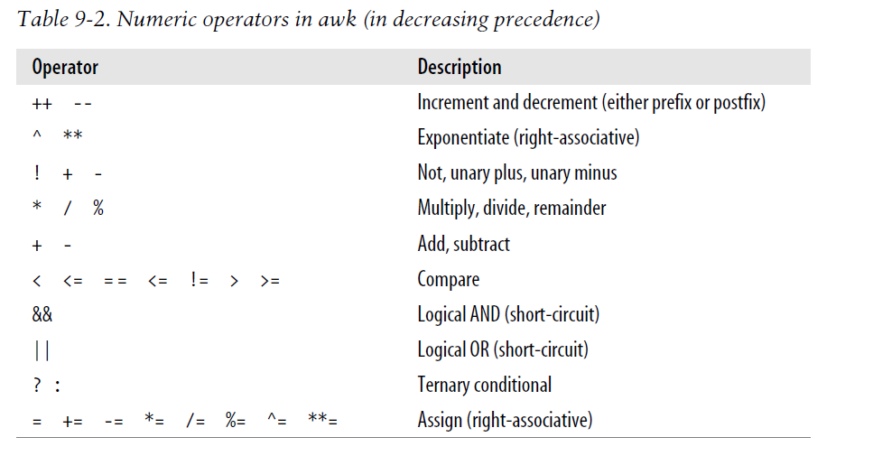

Slide 17
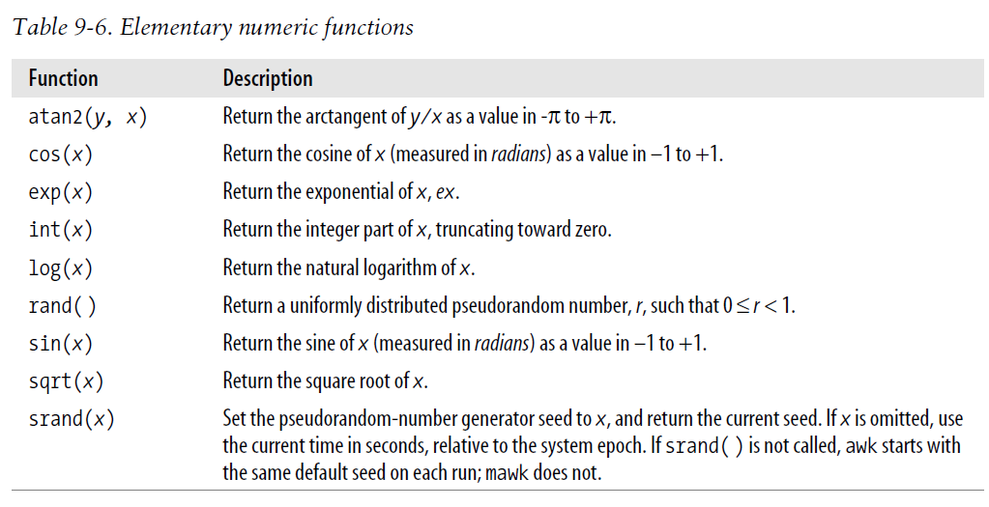

Slide 18
Working with strings
length(a): return the length of a stirng
substr (a, start, len): returns a copy of sub-string of len, starting at start-th character in a
substr(“abcde”, 2, 3) returns “bcd”
toupper(a), tolower(a): lettercase conversion
index(a,find): returns starting position of find in a
Index(“abcde”, “cd”) returns 3
match(a,regexp): matches string a against regular express regexp, return index if matching succeeed, otherwise return 0
Similar to (a ~ regexp): return 1 or 0

Slide 19
String matching
Two operators, ~ (matches) and !~ (does not match)
"ABC" ~ "^[A-Z]+$" is true, because the left string contains only uppercase letters,and the right regular expression matches any string of (ASCII) uppercase letters
Regular expression can be delimited by either quotes or slashes: "ABC" ~/^[A-Z]+$/

Slide 20
Working with strings: subtitute
sub (regexp, replacement, target)
gsub(regexp, replacement, target) -- global
Matches target against regexp, and replaces the lestmost (sub) or all (gsub) longest match by string replacement
E.g., gsub(/[^$-0-9.,]/,”*”, amount)
Replace illegal amount with *
To extract all constant string from a file
sub (/^[^"]+"/, "", value) ## replace everything before " by empty string
sub(/".*$/, "", value); ## replace everything after " by empty string

Slide 21
Working with string: splitting
split (string, array, regexp): break string into pieces stored in array, using delimiter as given by regexp
function split_path (target)
{
n = split (target, paths, "/");
for (k=1;k<=n;k++)
print paths[k]
##Alternative way to iterate through array:
## for (path in paths)
## print paths[path]
}
Demo:
string.awk

Slide 22
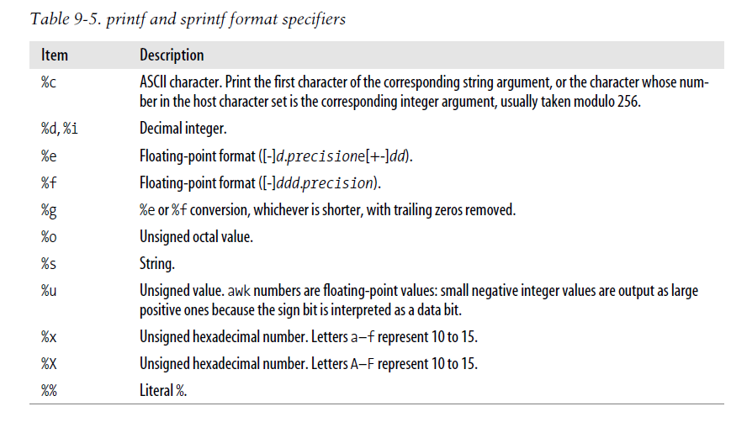
String formatting
sprintf(), printf ()

Slide 23
Outlines
Overview
awk command line
awk program model: record & field, pattern/action pair
awk program elements: variable, statement
Variable, Expression, Function
Numeric operators
String functions
Command line arguments
Array variable
Function
User-controlled input
Input/Output Redirection
External command

Slide 24
Awk: command line arguments
Recall the following keys about awk:
Command line syntax
awk [ -F fs ] [ -v var=value ... ] 'program' [ -- ] [ var=value ... ] [ file(s) ]
awk [ -F fs ] [ -v var=value ... ] -f programfile [ -- ] [ var=value ... ] [ file(s) ]
Program model
awk by default opens each file specified in command line, read one record at a time, and execute all matching actions in the program

Slide 25
Awk: command line arguments
run copy_awk
Read test.awk command, and test it
test.awk file1 file2 … filen
What happens and why?
Now try to call
test.awk file1 file2 targetfile=file3 v=3

Slide 26
Outlines
Overview
awk command line
awk program model: record & field, pattern/action pair
awk program elements: variable, statement
Variable, Expression, Function
Numeric operators
String functions
Command line arguments
Array variable
Function
User-controlled input
Input/Output Redirection
External command

Slide 27
awk array variables
Array can be indexed using integers or strings (associated array)
For example, ARGV[0], ARGV[1], …, ARGV[ARGC-1]
Demonstrate using example of grade calculation

Slide 28
Associative array
Suppose input file is as follows:
0.1 0.2 0.3 0.4 ## weights
A 90 ## A if total is greater than or equal to 90
B 80
C 70
D 60
F 0
alice 100 100 100 200
jack 10 10 10 300
smith 20 20 20 200
john 30 30 30 200
zack 10 10 10 10

Slide 29
#!/bin/awk -f
NR==1 { ## read the weights
for (num=1;num<=NF;num++)
{
w[num] = $num
}
}
/^[A-F] / {
## read the letter-grade mapping ##thresholds
thresh[$0] = $1
}
/^[a-z]/ {
# this code is executed once for each line
sum=0;
for (col=2;col<=NF;col++)
sum+=($col*w[col-1]);
printf ("%s %d ", $0, sum);
if (sum>=thresh["A"])
print "A"
else if (sum>=thresh["B"])
print "B"
else if (sum>=thresh["C"])
print "C"
else if (sum>=thresh["D"])
print "D"
else print "F"
}
Need $ when refer to the fields in the record
No $ for other variables !
weighted_array.awk

Slide 30
Outlines
Overview
awk command line
awk program model: record & field, pattern/action pair
awk program elements: variable, statement
Variable, Expression, Function
Numeric operators
String functions
Array variable
Function
User-controlled input
Input/Output Redirection
External command

Slide 31
Awk user-defined function
Can be defined anywhere: before, after or between pattern/action groups
Convention: placed after pattern/action code, in alphabetic order
function name(arg1,arg2, …, argn)
{
statement(s)
}
name(exp1,exp2,…,expn);
result = name(exp1,exp2,…,expn);
return statement: return expr
Terminate current func, return control to caller with value of expr
Default value: 0 or “” (empty string)
Named argument: local variable to function,
Hide global var. with same name

Slide 32
Variable and argument
function a(num)
{
for (n=1;n<=num;n++)
printf ("%s", "*");
}
{
n=$1
a(n)
print n
}
Todo:
What’s the output?
echo 3 | awk –f global_var.ark
2. Try it …
Warning: Variables used in function body, but not included in argument list are global variable

Slide 33
Solution: make n local variable
Hard to avoid variables with same name ☹, espeically i, j, k, ...
function a(num, n)
{
for (n=1;n<=num;n++)
printf ("%s", "*");
}
{
n=$1
a(n)
print n
}
Convention, list non-argument local variables last, with extra leading spaces
Todo:
What’s the output now?
echo 3 | awk –f global_var.ark

Slide 34
Awk function
factoring.awk
#!/bin/awk -f
function factor (number)
{
factors="" ## intialize string storing the factoring result
m=number; ## m: remaining part to be factored
for (i=2;(m>1) && (i^2<=m);) ## try i, i start from 2, goes up to sqrt of m
{
## code omitted …
}
if ( m>1 && factors!="" ) ## if m is not yet 1,
factors = factors " * " m
print number, (factors=="")? " is prime ": (" = " factors)
}
{ factor($1);} ## call factor function to factor first field for each record
Do these:
1. Test it:
echo 2013 | factoring.awk
2. Modify to return factors
string, instead of print it
3. Add a function, isPrime,
Hint: you can call factor()
4. For each line in inputs,
count # of prime numbers
in the line

Slide 35
Outlines
Overview
awk command line
awk program model: record & field, pattern/action pair
awk program elements: variable, statement
Variable, Expression, Function
Numeric operators
String functions
Array variable
Function
User-controlled input
Input/Output Redirection
External command

Slide 36
User-controlled Input
Usually, one does not worry about reading from file
You specify what to do with each line of inputs
Sometimes, you want to
Read next record: in order to processing current one …
Read different files:
Dictionary files versus text files (to spell check): need to load dictionary files first …
Read record from a pipeline:
Use getline

Slide 37
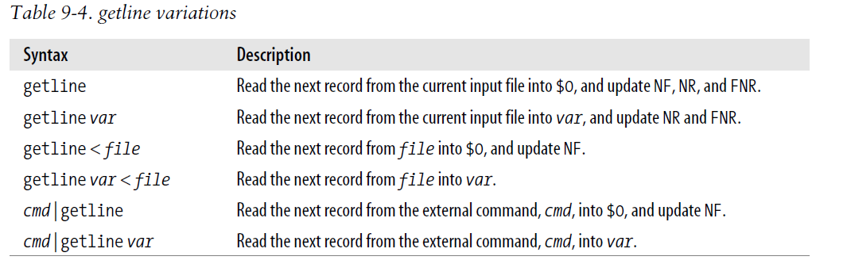
User-controlled Input

Slide 38
Usage of getline
Interact awk
$ awk 'BEGIN {print "Hi:"; getline answer; print "You said: ", answer;}'
Hi:
Yes?
You said: Yes?
To load dictionary:
nwords=1
while ((getline words[nwords] < “/usr/dict/words”)>0)
nwords++;
To set current time into a variable
“date” | getline now
close(“date”)
print “time is now: “ now

Slide 39
Output redirection: to files
#!/bin/awk -f
#usage: copy.awk file1 file2 … filen target=targetfile
BEGIN {
if (ARGC<2)
{
print "Usage: copy.awk files... target=target_file_name"
exit
}
for (k=0;k<ARGC;k++)
if (ARGV[k] ~ /target=/)
{ ## Extract target file name
target_file=substr(ARGV[k],8);
}
printf " " > target_file
close (target_file)
}
END {close(target_file); } ## optional, as files will be closed upon termination
{
print FILENAME, $0 >> target_file
}
Todo:
Try copy.awk out
Access command line
arguments

Slide 40
Output redirection: to pipeline
#!/bin/awk -f
# demonstrate using pipeline
BEGIN {
FS = ":"
}
{ # select username for users using bash
if ($7 ~ "/bin/bash")
print $1 >> "tmp.txt"
}
END{
while ((getline < "tmp.txt") > 0)
{
cmd="mail -s Fellow_BASH_USER " $0
print "Hello," $0 | cmd
## send an email to every bash user
}
close ("tmp.txt")
}

Slide 41
Execute external command
Using system function (similar to C/C++)
E.g., system (“rm –f tmp”) to remove a file
if (system(“rm –f tmp”)!=0)
print “failed to rm tmp”
A shell is started to run the command line passed as argument
Inherit awk program’s standard input/output/error

Slide 42
Outline
Overview
awk command line
awk program model: record & field, pattern/action pair
awk program elements: variable, statement
Variable, Expression, Function
Numeric operators
String functions
Array variable
Function
User-controlled input
Input/Output Redirection
External command

